Slide 1


The Author-topic model applied to tweets for Bitcoin price prediction
Team Doctrina Apparatus
HO Ngok Chao
CHEN Zhiwei
LIAN Zirui

Slide 2
Abstract
First step, we used Tweets of selected accounts and author topic model to find topic (word distribution).
Second step, Topic Trends (time series) are identified for twitter text across time.
Third Step, these topic trends are then used as input features for neural network, LSTM to predict Bitcoin price.

Slide 3
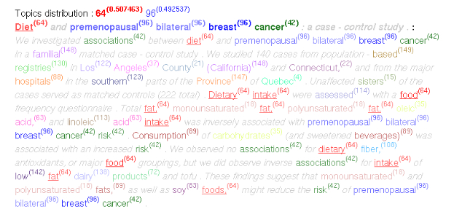
Literature review
What is Topic model? What is Author-Topic Model?

Slide 4
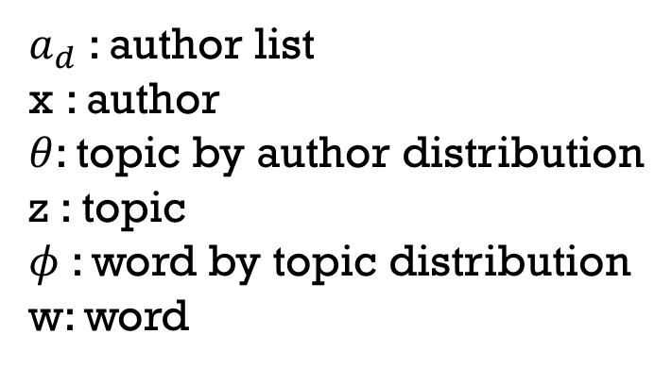
Generative Mechanism of author topic model
$a_{d}$: author list
x : author
$θ$: topic by author distribution
z : topic
$φ$: word by topic distribution
w: word

Slide 5
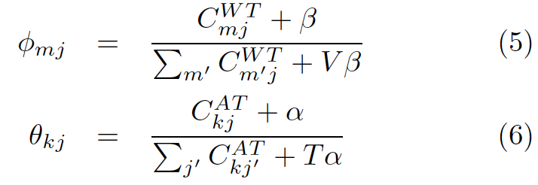
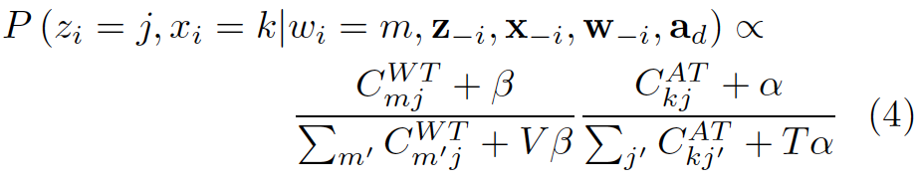
Parameter estimation by Gibbs sampling
Step 1 Assign words to random topics and authors.
Step 2 Apply Equation (4) to every word in the text and do assignment accordingly.
Step 3 Repeat step 2, 2000 times and save the word by topic matrix (5) and author by topic matrix (6).

Slide 6
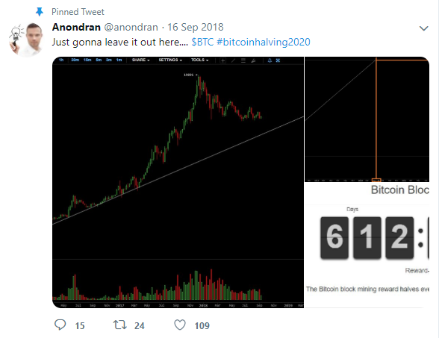
9 Authors
@anondran
@dtapscott
@francispouilot
@HeyTaiZen
@iamjosephyoung
@jonmatonis
@TuurDemeester
@VinnyLingham
@woonomic

Slide 7
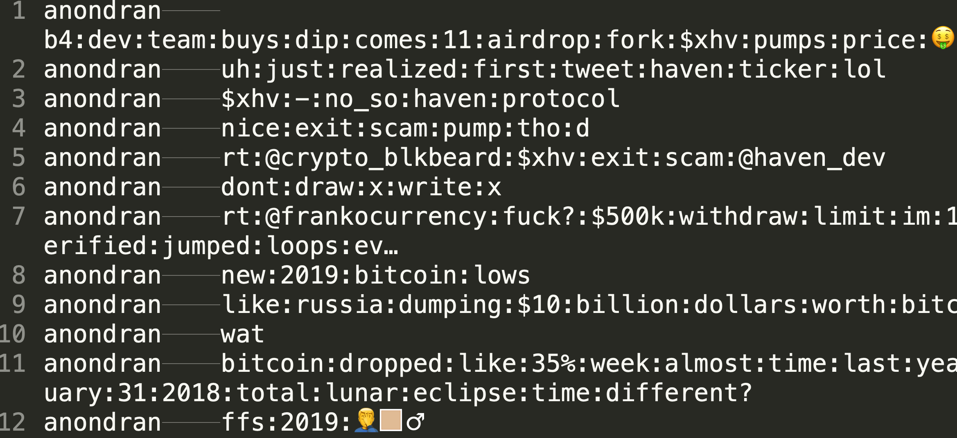
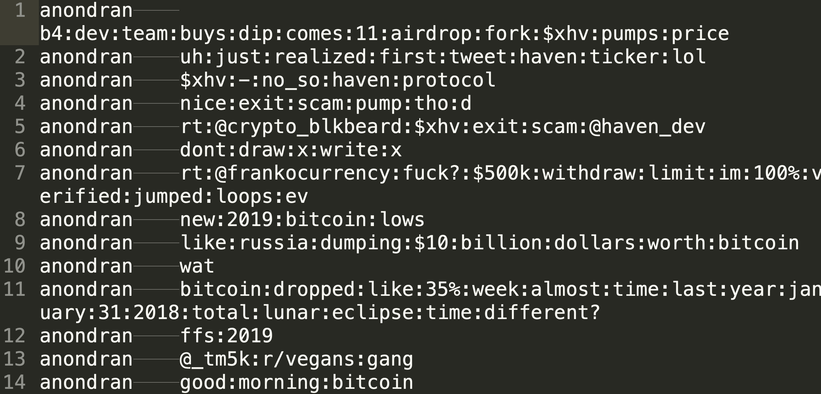
Data cleaning (with and without emoji)

Slide 8
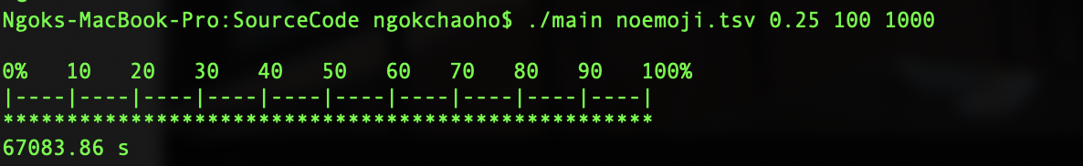
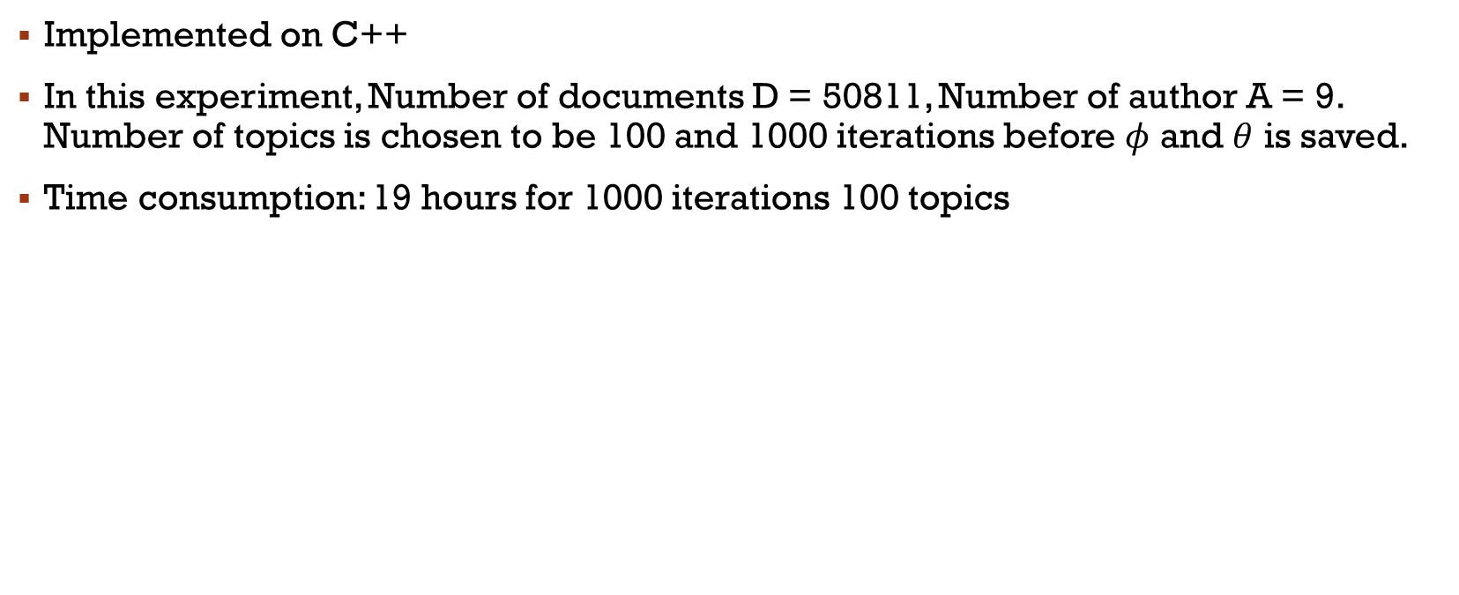
Implementation
Implemented on C++
In this experiment, Number of documents D = 50811, Number of author A = 9. Number of topics is chosen to be 100 and 1000 iterations before $φ$ and $θ$ is saved.
Time consumption: 19 hours for 1000 iterations 100 topics

Slide 9
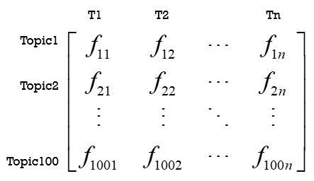
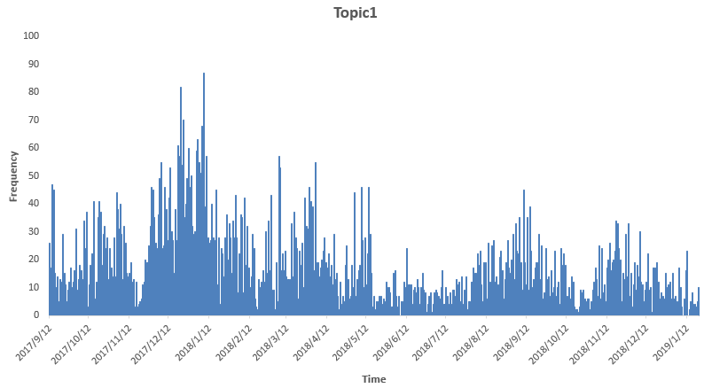
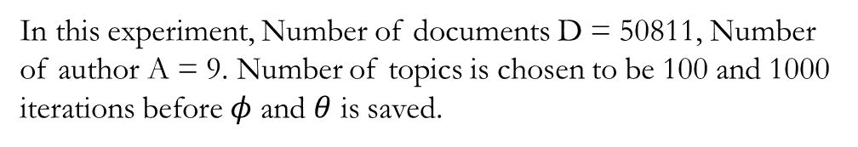
Topic trend
Step 1 Determine which topic the words belongs to according to its highest probability over 100 topics
Step 2 count the frequency of the words under each topic
Step 3 Generate time-distributed matrix for different topics
Topic Distribution
Topic Trend Graph
In this experiment, Number of documents D = 50811, Number of author A = 9. Number of topics is chosen to be 100 and 1000 iterations before $φ$ and $θ$ is saved.

Slide 10
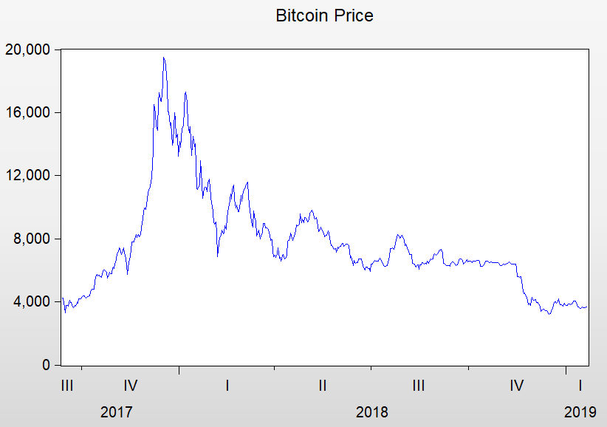
EMPIRICAL TEST
Step 1 ADF TEST
Step 2 Linear regression
R-Square<1%, Non-linear
ADF | t-Statistic | Prob.*
DIF_LOG_PRICE | -21.08865 | 0.0000
DPRICE | -20.62311 | 0.0000
DIF_LOG_PRICE: difference of log(price)
DPRICE: difference of price

Slide 11
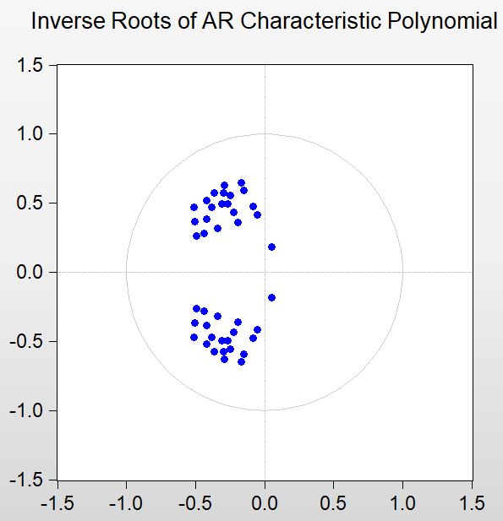
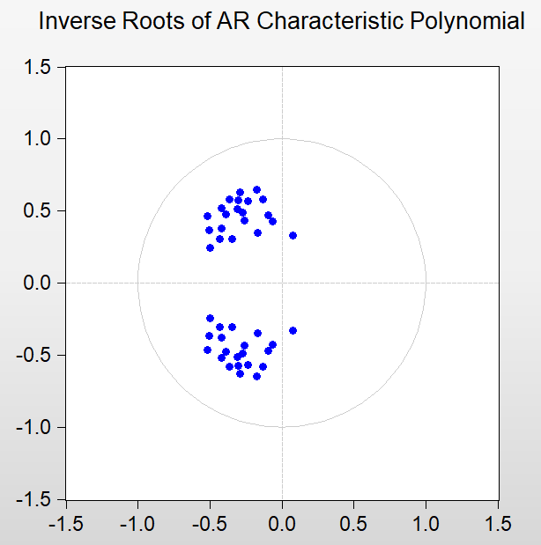
Step 3 Granger Causality Test
 |  | Topics
DIF_LOG_PRICE | <0.05 | D2/D6/D8/D9/D13/D22/D33/D29/D36/D37/D54/D55/D58/D63/D66/D67/D68/D85/D93
 | <0.1 | (Include above)D16/D17/D19/D26/D33/D65/D78/D86
DPRICE | <0.05 | D13/D14/D16/D19/D2/D22/D23/D29/D32/D33/D35/D36/D39/D49/D58/D59/D6/D66/D67/D69/D77/D79/D8/D99/D100
 | <0.1 | (Include above)D1/D17/D41/D62/D78/D93/D94
Common factors:
D2/D13/D22/D23/D29/D36/D58/D6/D66/D67/D69/D8/D17/D93
So to reduce the numbers of factors, We use their common factors
Step 4 AR Graph
DIF_LOG_PRICE
DPRICE

Slide 12
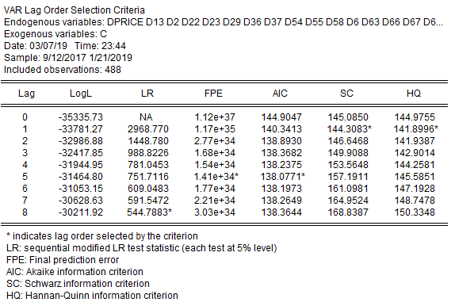
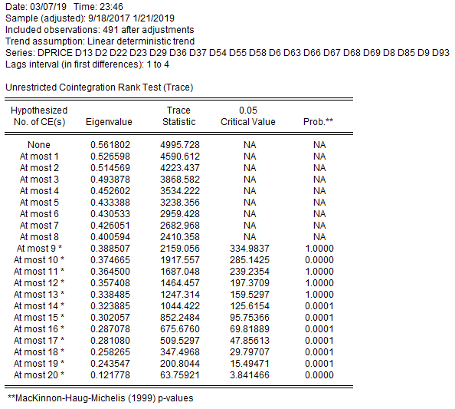
Step 5 Lag_Structure
DPRICE lag-order=5
DIF_LOG_PRICE lag-order>15
So we can use DPRICE rather than DIF_LOG_PRICE
to show the lag-period influence.
Step 6 Cointegration Test

Slide 13
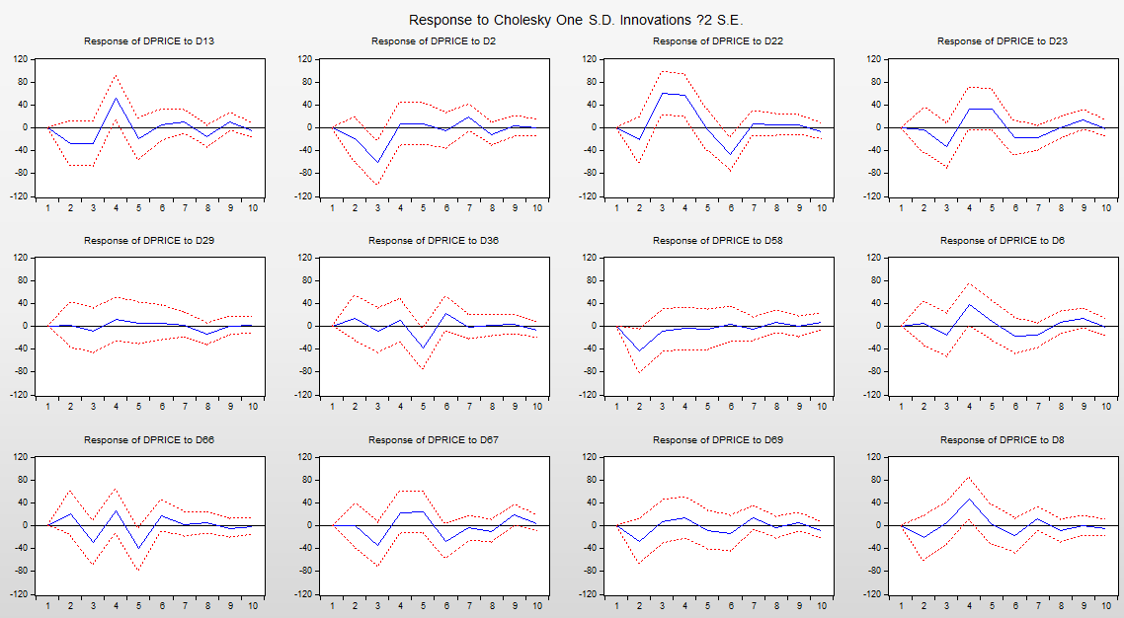
Step 7 PCA
PCA result is not useful, after 10 PCs can only over 85% total variance.
Step 8 Impulse Responses
Can read the fluctuation direction from the graph.
Finally converge to zero.

Slide 14
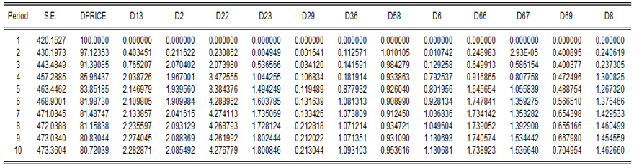
Step 9 Variance Decomposition
Most of the variance is caused by the price fluctuation itself
Until 10 periods, D22 cause 4.27%, D13 and D2 cause 2%

Slide 15
Step 10 Advanced Comparison
Use the data with emoji (emoji also contains a lot of information nowadays)
Re-run and Re-test
Common factors:
D13/D14/D2/D22/D23/D29/D36/D54/D58/D6/D66/D67/D69/D8/D85/D9
Red highlight is the additional factors compared with the results without emoji

Slide 16
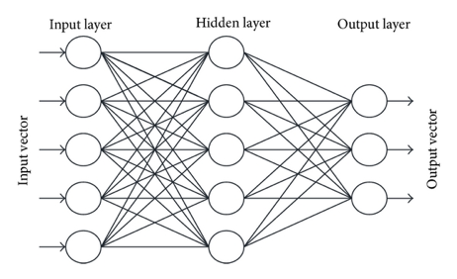
Bitcoin PRICE Prediction
Method 1: BP Neural Network
Multi-layered neural network
Approximate non-linear relationship between input and output by adjusting the weight values internally

Slide 17
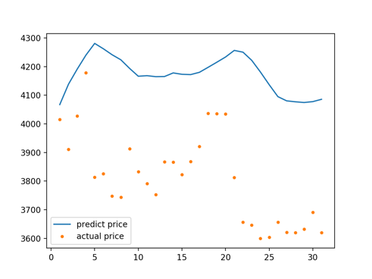
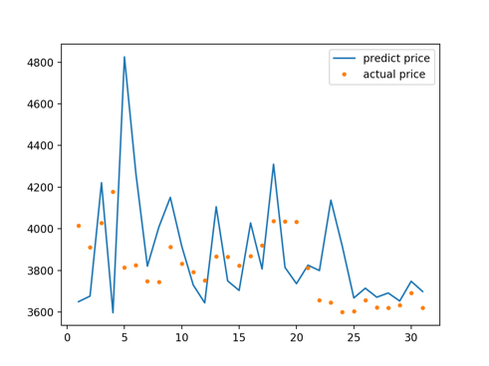
Bitcoin PRICE Prediction
Method 1: BP Neural Network

Slide 18
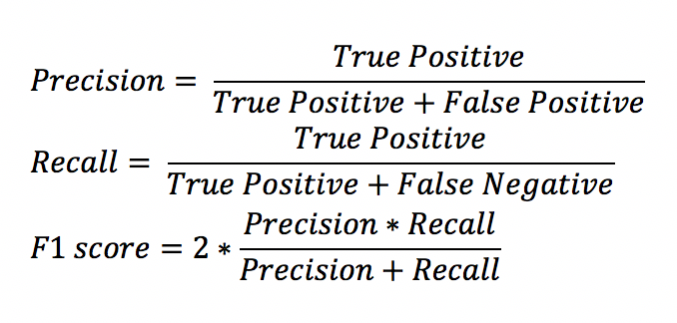
Bitcoin PRICE Prediction
Method 1: BP Neural Network
 | Without topics | With topics | With emojis
MSE | 42784.8824 | 123482.8374 | 110075.8657
MAPE | 0.04633 | 0.0832 | 0.08
Precision | 0.4286 | 0.5625 | 0.4667
Recall | 0.4615 | 0.6923 | 0.5385
F1 score | 0.4444 | 0.6209 | 0.5

Slide 19
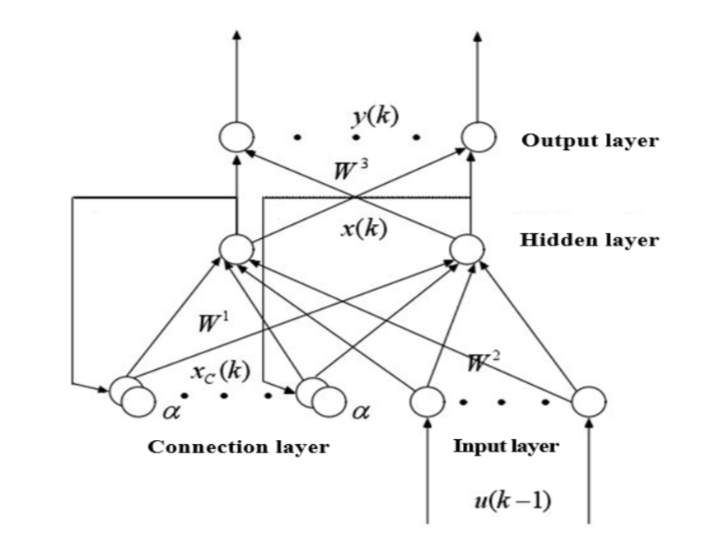
Bitcoin PRICE Prediction
Method 2: Elman Neural Network
Feedback neural network
The structure includes input layer, hidden layer, connection layer and output layer.
Because of the connection layer, the network system has ability to adapt to the time-varying dynamic characteristics and has strong global stability.

Slide 20
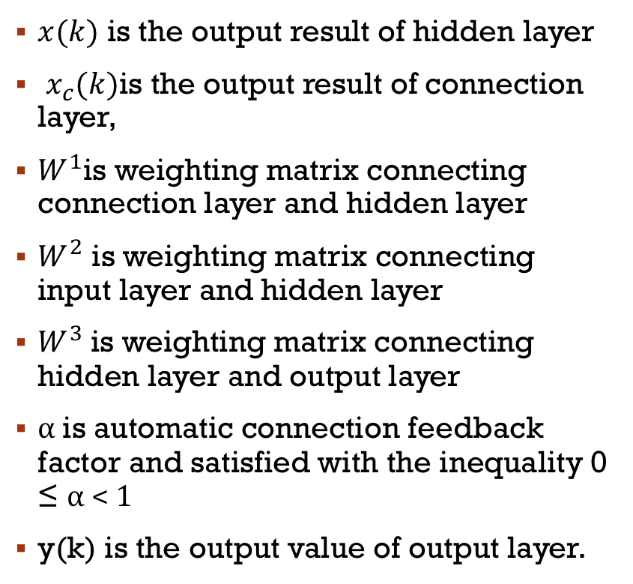
Bitcoin PRICE Prediction
$x(k)$ is the output result of hidden layer
$x_{c}(k)$is the output result of connection layer,
$W^{1}$is weighting matrix connecting connection layer and hidden layer
$W^{2}$ is weighting matrix connecting input layer and hidden layer
$W^{3}$is weighting matrix connecting hidden layer and output layer
α is automatic connection feedback factor and satisfied with the inequality 0 ≤ α < 1
y(k) is the output value of output layer.

Slide 21
Bitcoin PRICE Prediction
Method 2: Elman Neural Network
Figure 1: Prediction results without topics Figure 2: Prediction results with topics Figure 3: Prediction results with emoji

Slide 22
Bitcoin PRICE Prediction
Method 2: Elman Neural Network
 | Without Topic Distribution | With Topic Distribution | With Topic Distribution(with emoji)
MSE | 27925.150250394912 | 199364.10809882634 | 1063614.101706619
MAPE | 0.031908484496669505 | 0.09344604001253237 | 0.3547390113601053
Precision | 0.4375 | 0.5625 | 0.6
Recall | 0.5384615384615384 | 0.6923076923076923 | 0.6923076923076923
F1 score | 0.4827586206896552 | 0.6206896551724138 | 0.6428571428571429

Slide 23
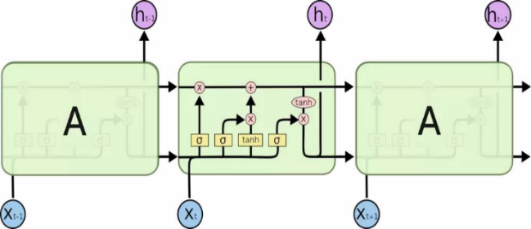
Bitcoin PRICE Prediction
Method 3: LSTM Neural Network
LSTM is an extension for standard Recurrent Neural Networks (RNN) including Elman neural network.
LSTM enable RNN to remember their inputs over a long period of time. The problematic issues of vanishing gradients of RNN is solved through LSTM because it keeps the gradients steep enough and therefore the training relatively short and the accuracy high.

Slide 24
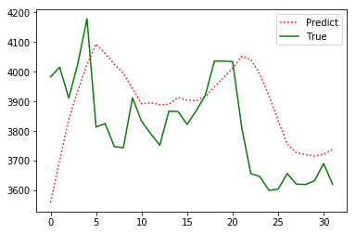
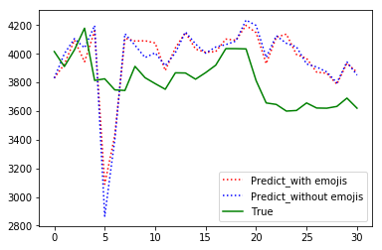
Bitcoin PRICE Prediction
Method 3: LSTM Neural Network

Slide 25
Bitcoin PRICE Prediction
Method 3: LSTM Neural Network
 | Without topics | With topics (with emojis) | With topics (without emojis)
MSE | 37814.1345 | 86929.8808 | 97814.6009
MAPE | 4.0833 | 6.778 | 6.88131
Precision | 0.4667 | 0.3846 | 0.3571
Recall | 0.5385 | 0.4167 | 0.4167
F1 score | 0.5 | 0.4 | 0.3846

Slide 26
Thank you
Team Doctrina Apparatus

